Slide 1
Intracellular recordings in the ELL of a weakly electric fish
Kathrin Root, Alexander Wendt, Patrick Weygoldt

Slide 2
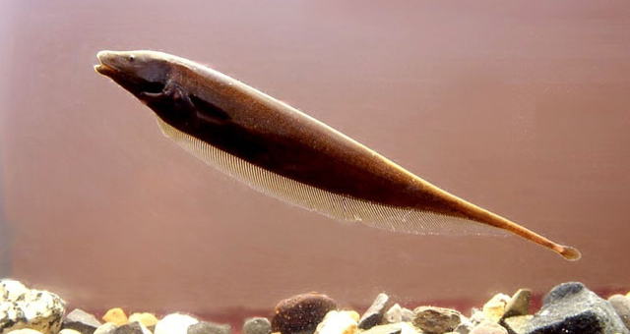
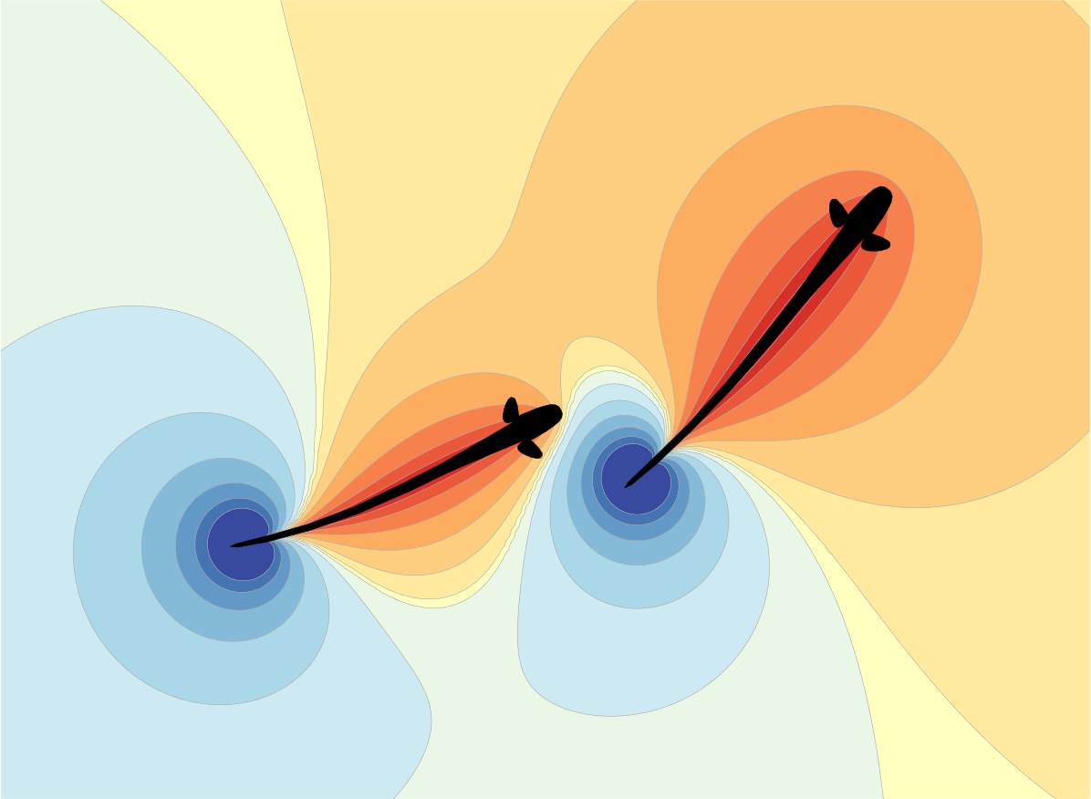
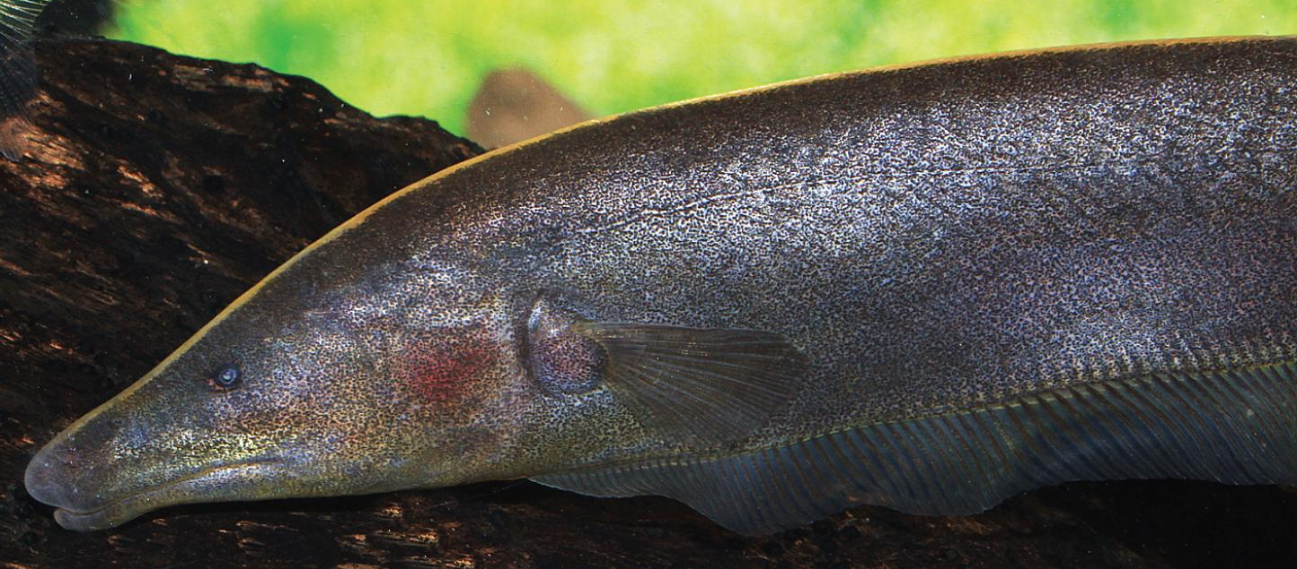
Introduction - Apteronotus leptorhynchus
… Electrolocate & communicate via a self generated electric field!
https://www.fishbase.se/images/species/Aplep_u7.jpg
https://www.aqualog.de/wp-content/uploads/2016/08/brown_ghost.jpg
https://bendalab.github.io/pubs/Benda2020-ElectrosensoryWorlds.pdf

Slide 3
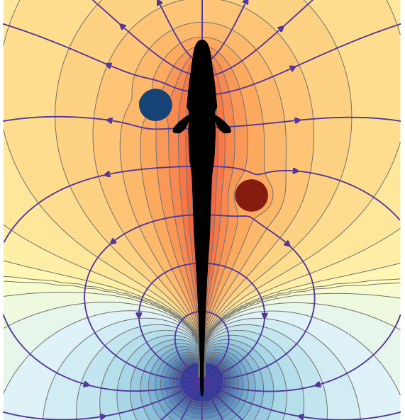
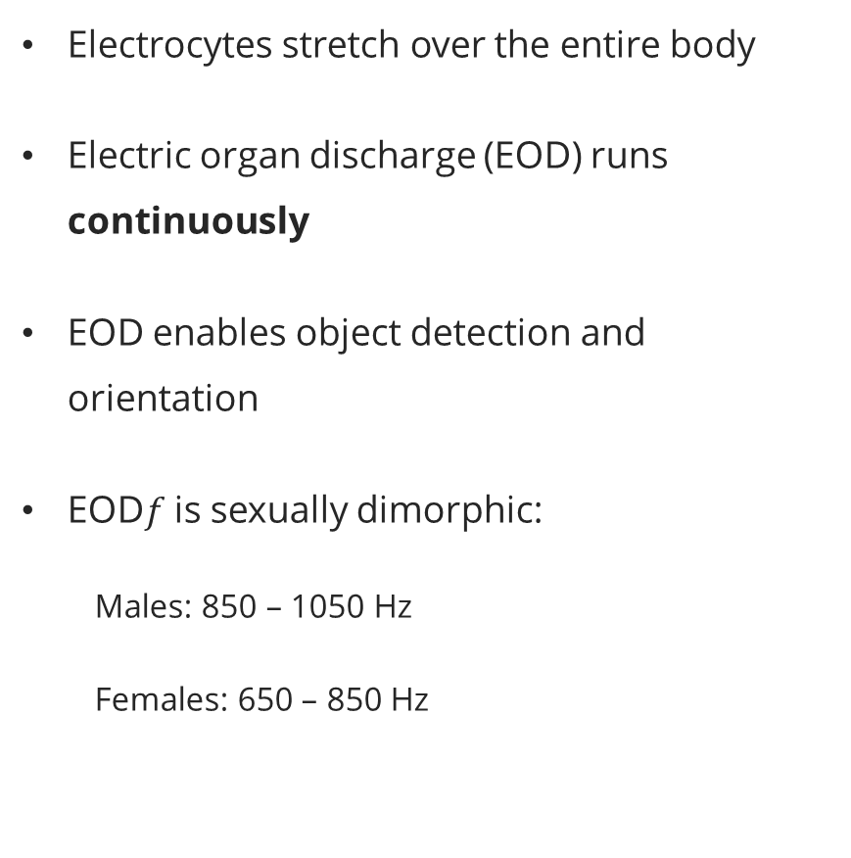
Introduction – Electric organ
Electrocytes stretch over the entire body
Electric organ discharge (EOD) runs continuously
EOD enables object detection and orientation
EOD$f$ is sexually dimorphic:
Males: 850 – 1050 Hz
Females: 650 – 850 Hz
https://bendalab.github.io/pubs/Benda2020-ElectrosensoryWorlds.pdf

Slide 4
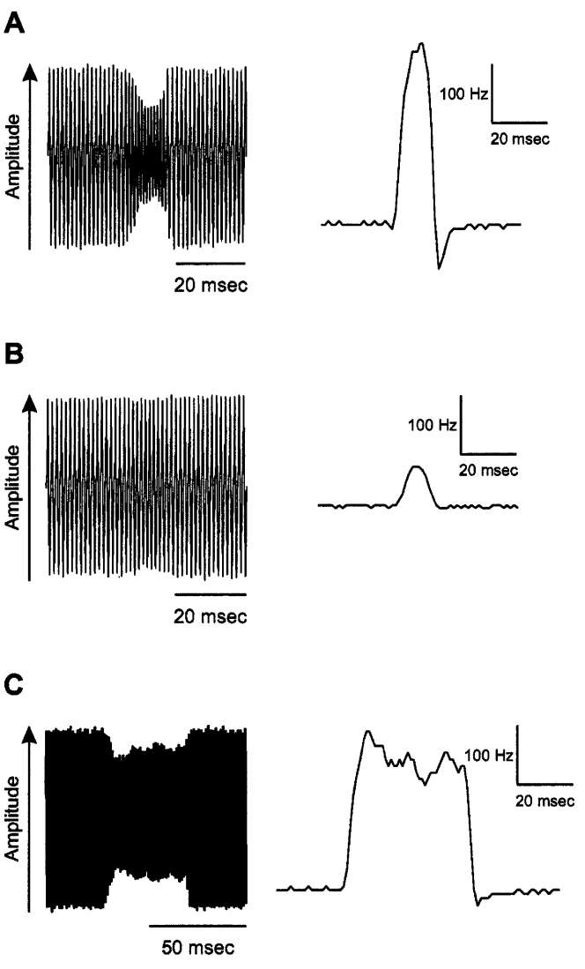
Introduction - Electrocommunication
A: Type 1 chirp, territorial signal
B: Type 2 chirp, aggressive threat signal
C: Type 3 chirp, mating signal paper
G. Engler, G.K.H. Zupanc (2001)

Slide 5
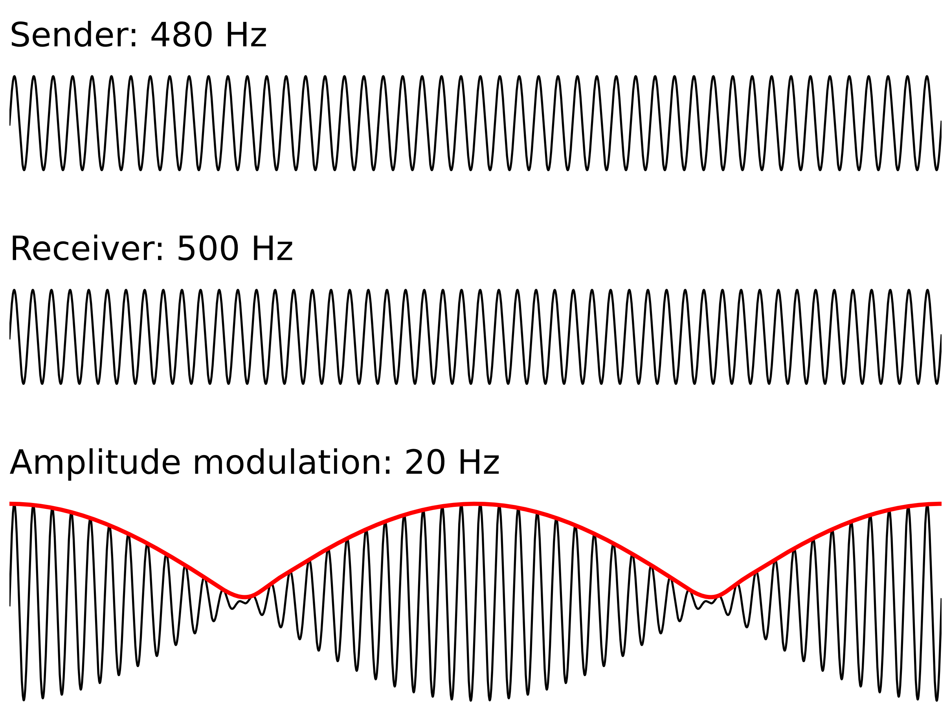
Introduction - Electrocommunication
https://bendalab.github.io/pubs/Benda2020-ElectrosensoryWorlds.pdf

Slide 6
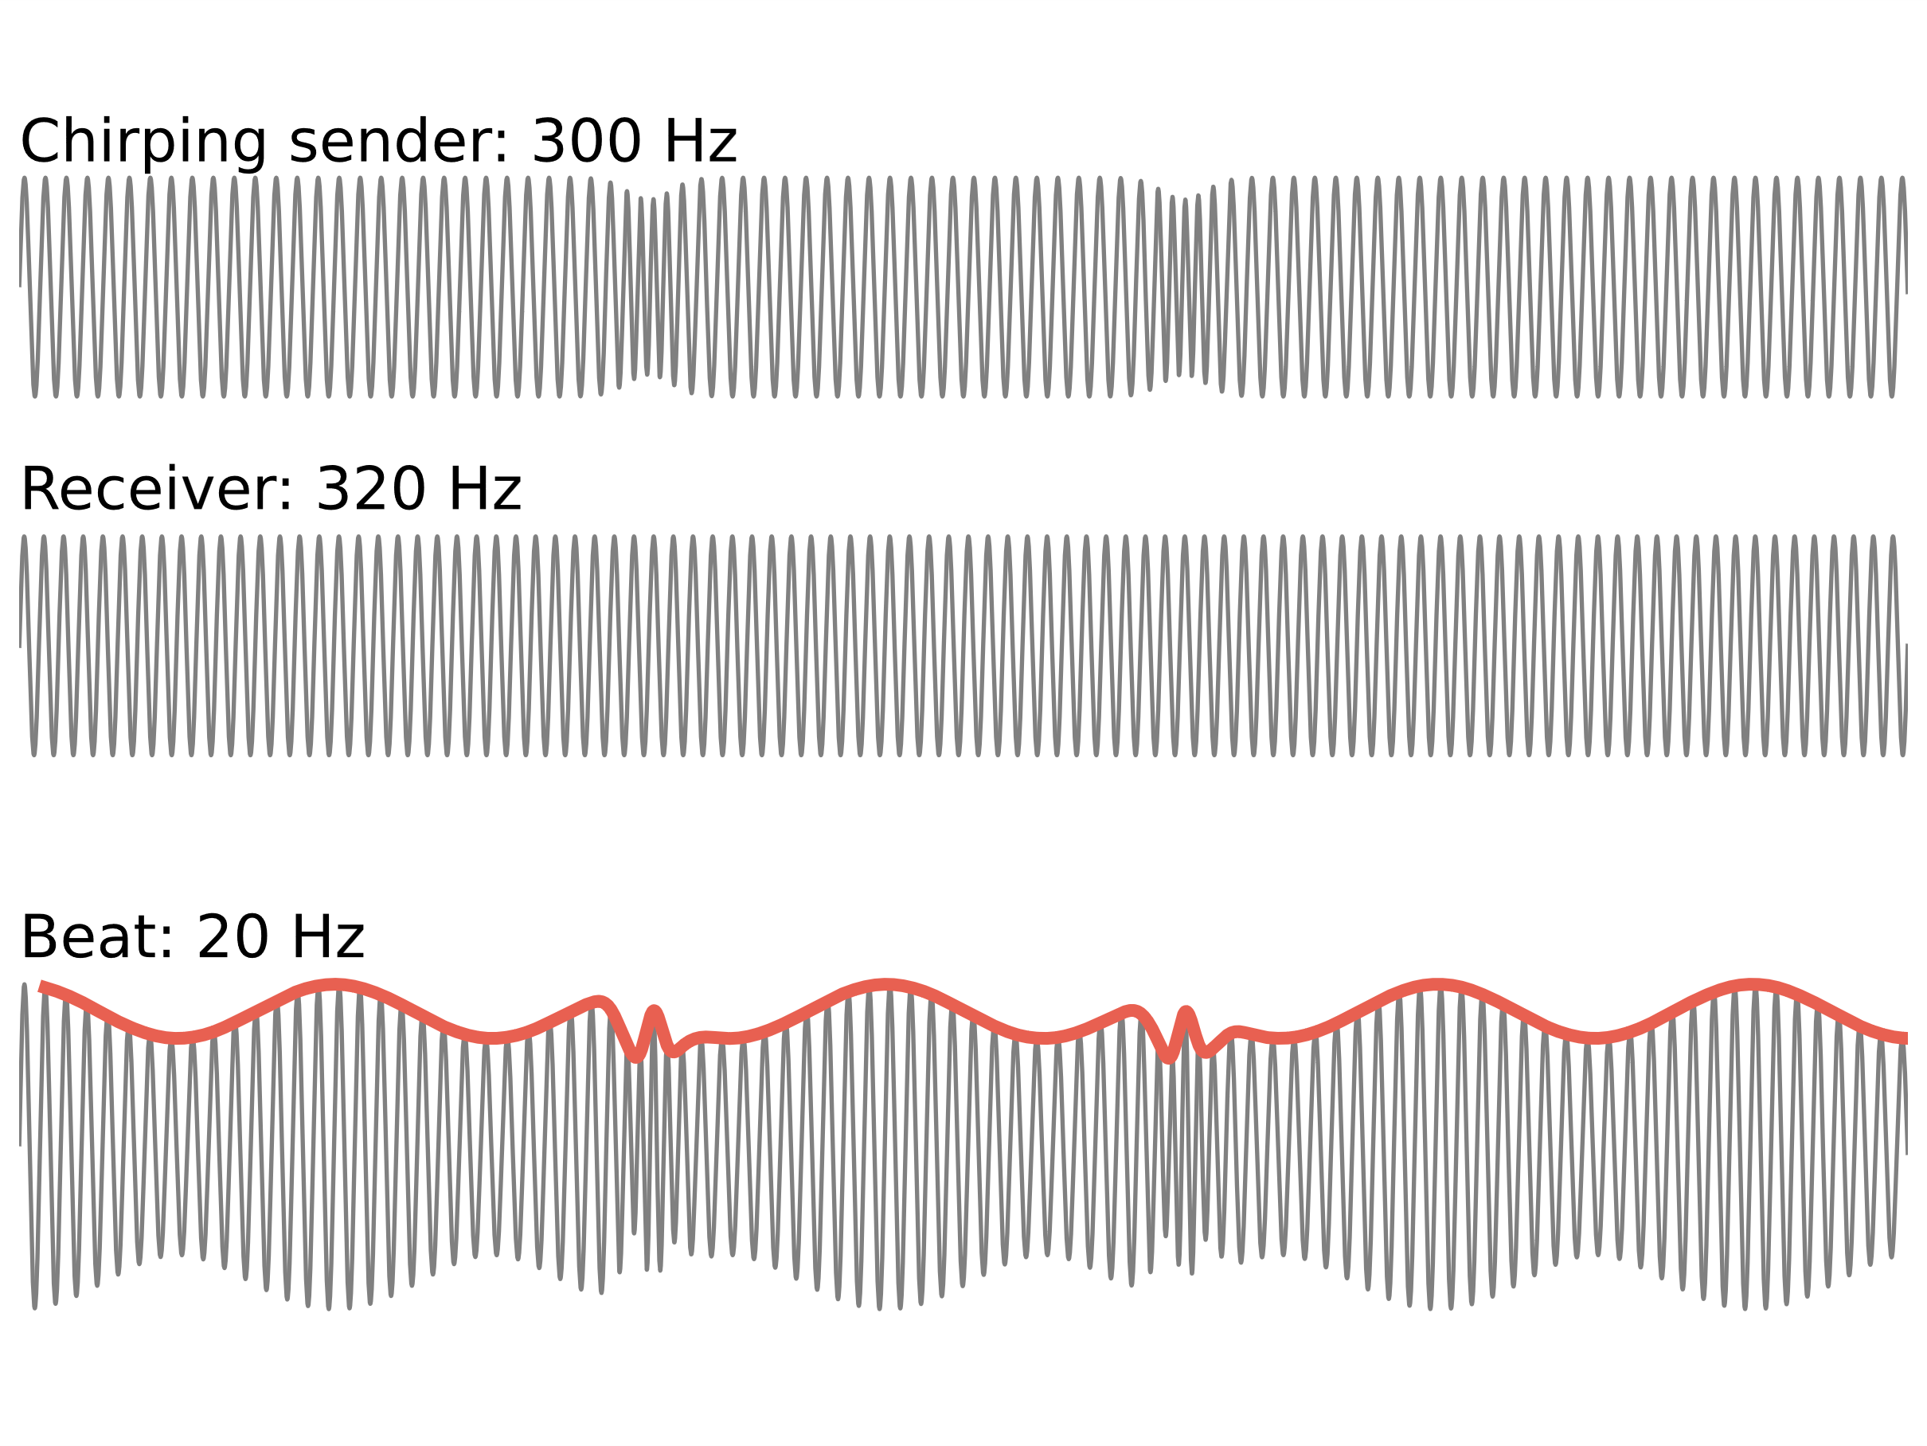
Introduction - Electrocommunication

Slide 7
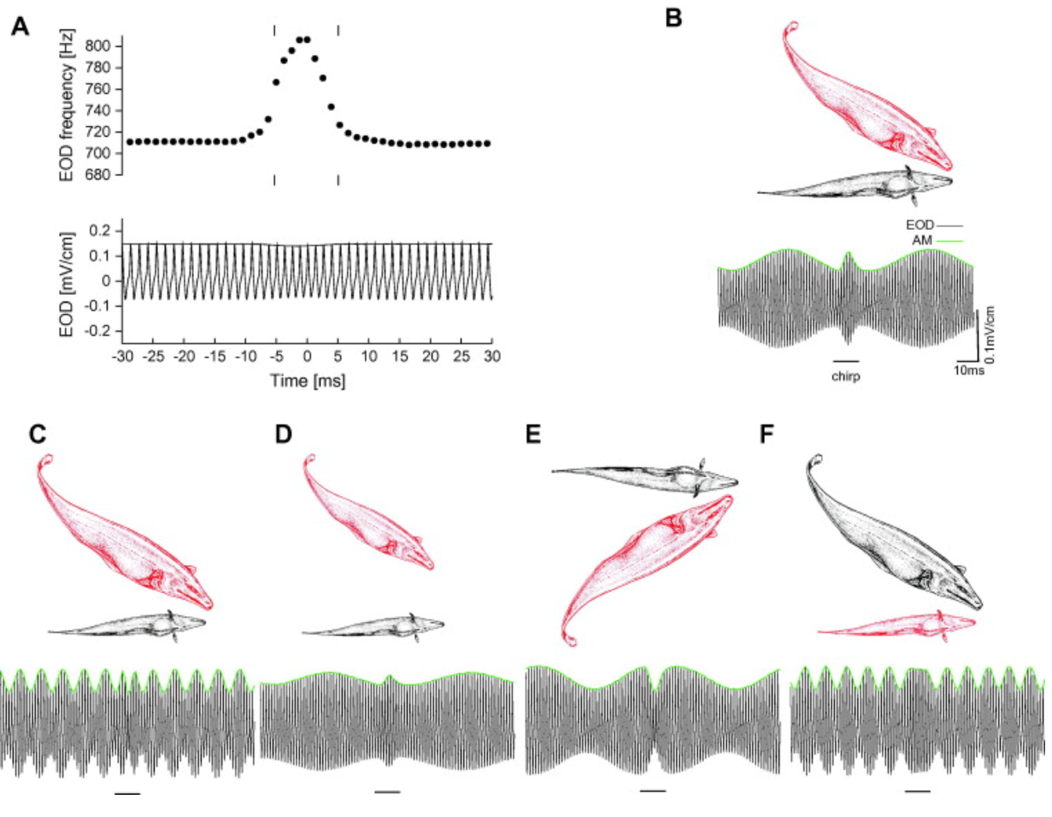
Introduction - Electrocommunication
Henriette Walz, 2013

Slide 8
Introduction – P-units
P-units = electrocytes
Spontaneous activity
React to own electric field
Project into the electrosensory lateral line lobe (ELL)

Slide 9
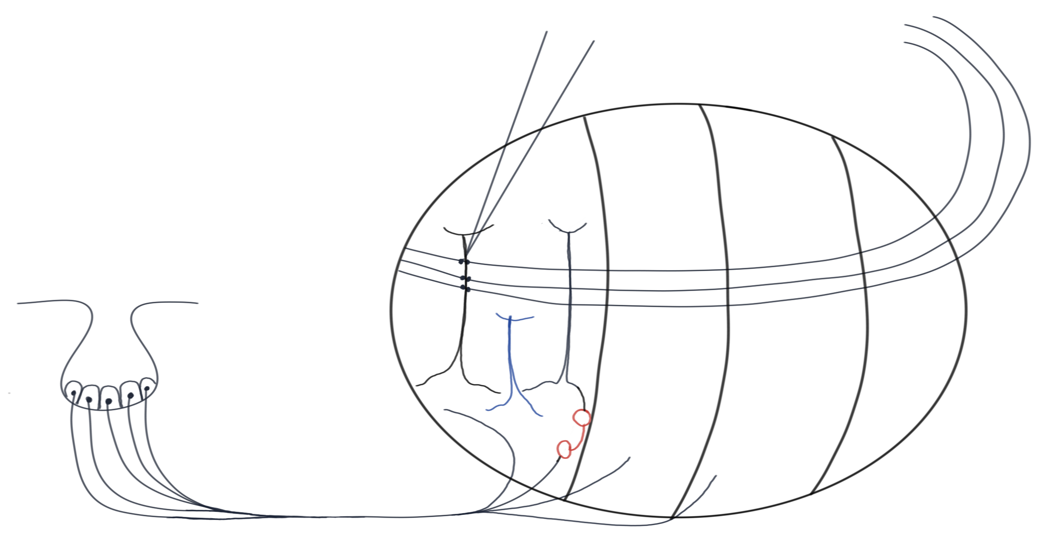
Introduction – ELL pyramidal cells
Electrode
Inhib. feedback
CLS
CMS
Superficial pyramidal cell
LS
MS
Deep pyramidal cell
Interneuron
P-Unit

Slide 10
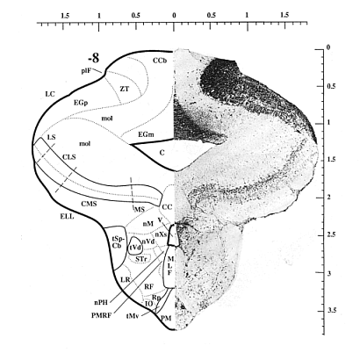
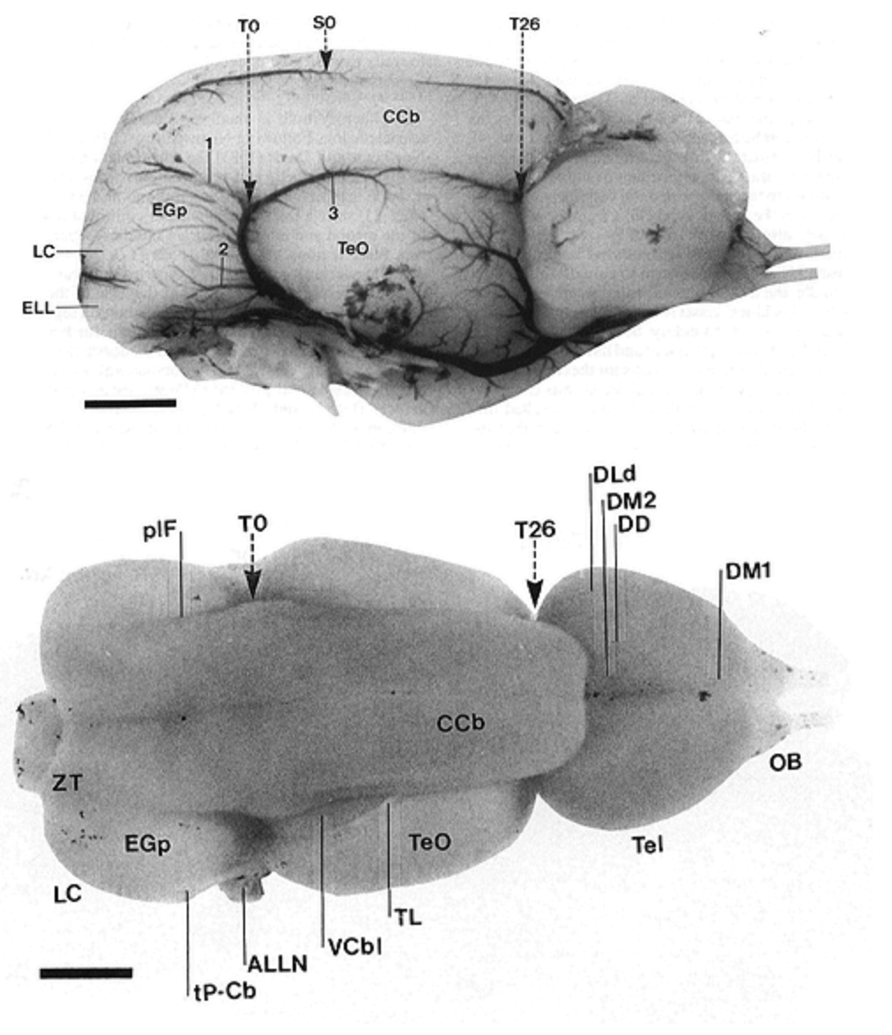
Introduction – Brain regions
http://nelson.beckman.illinois.edu/atlas.html
http://nelson.beckman.illinois.edu/atlas.html

Slide 11
Research aim
Literature stimuli are confined to small frequency ranges source
Natural stimulus regime is much more diverse source
How are chirps encoded for diverse difference frequencies?
Find ELL pyramidal cells …
Does the cell react to a chirp?
…

Slide 12
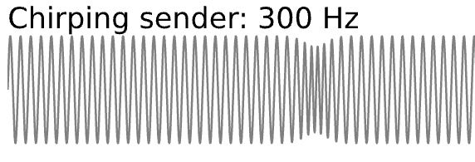
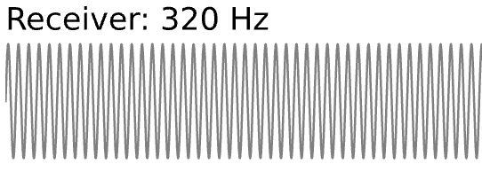


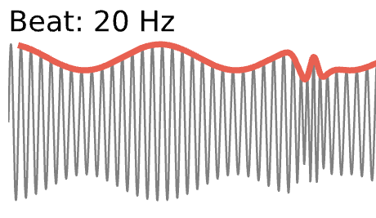
Methods – Recording setup
DAQ
Relacs
Stimulus isolator
Local EOD
Membrane potential
Multiplier addition
Global EOD
Stimulus electrode

Slide 13
Results - Baseline

Slide 14
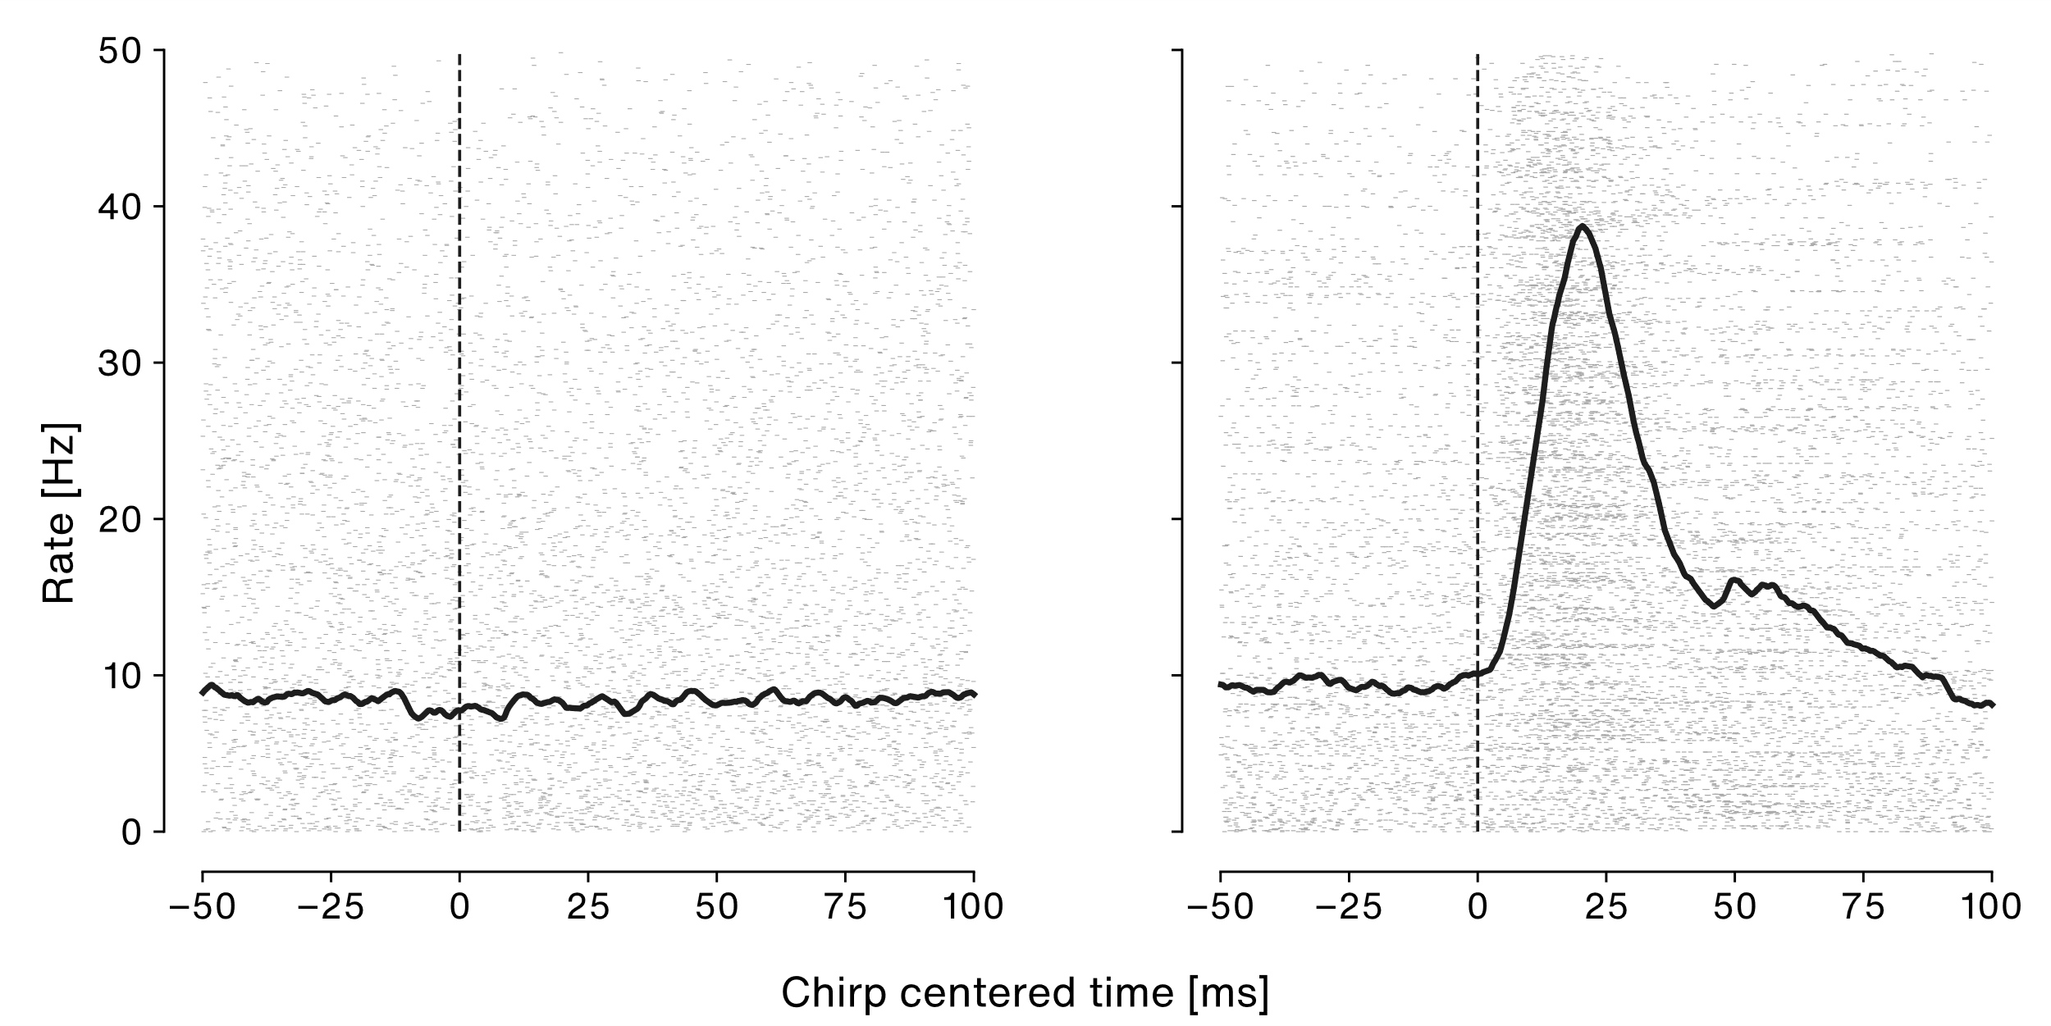
Results – Chirp response

Slide 15
Results – Chirp response
Our cell!

Slide 16
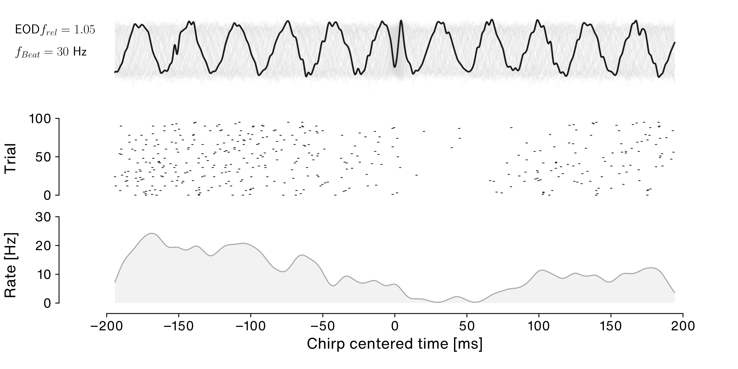
Results – Chirp response

Slide 17
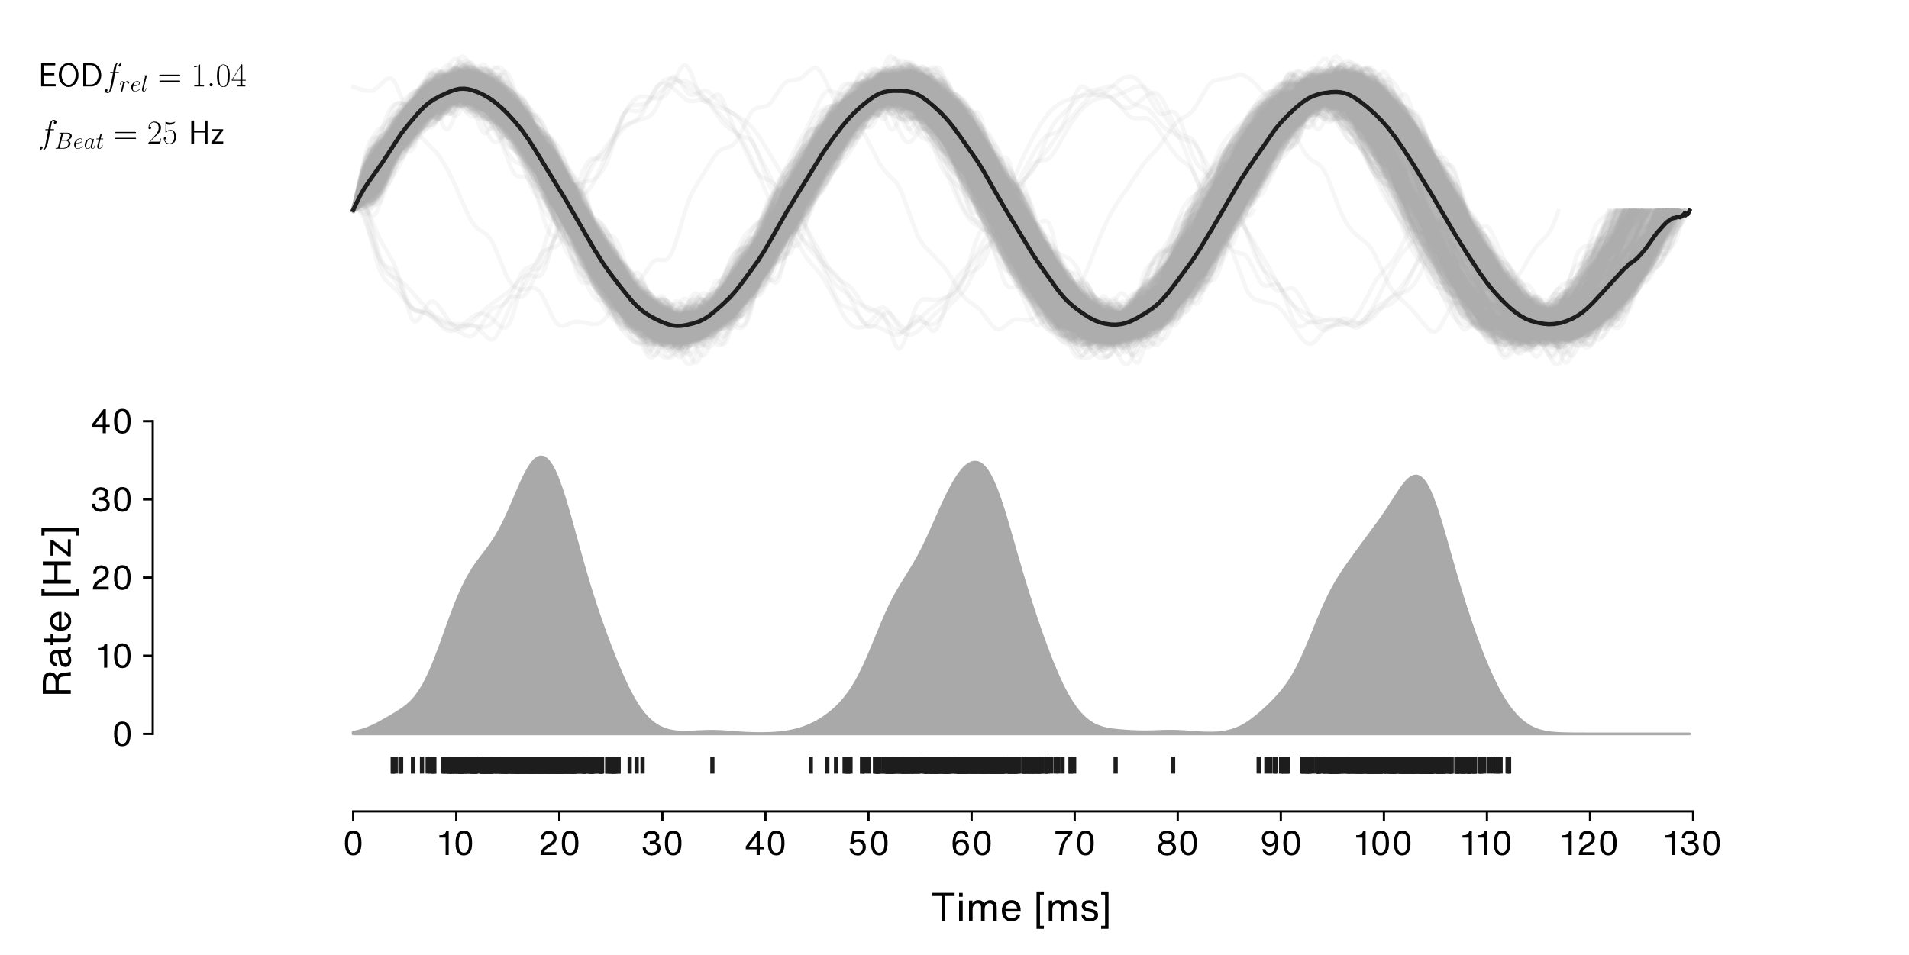
Results – Beat response

Slide 18
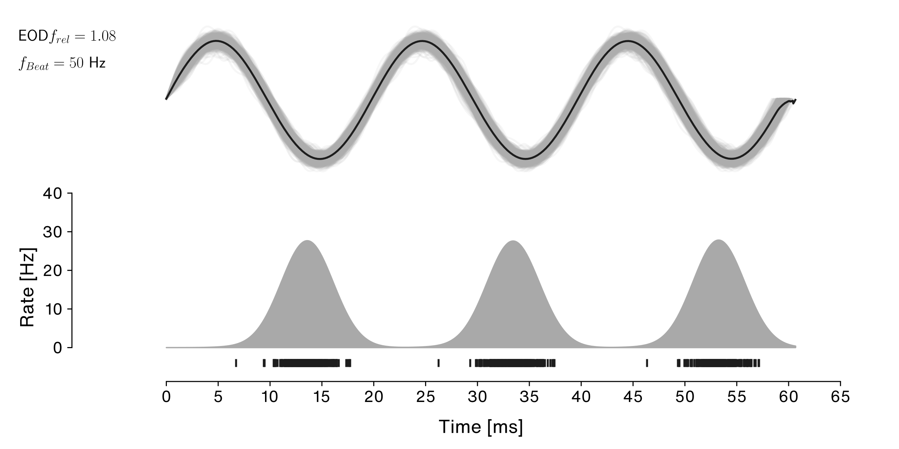
Results – Beat response

Slide 19
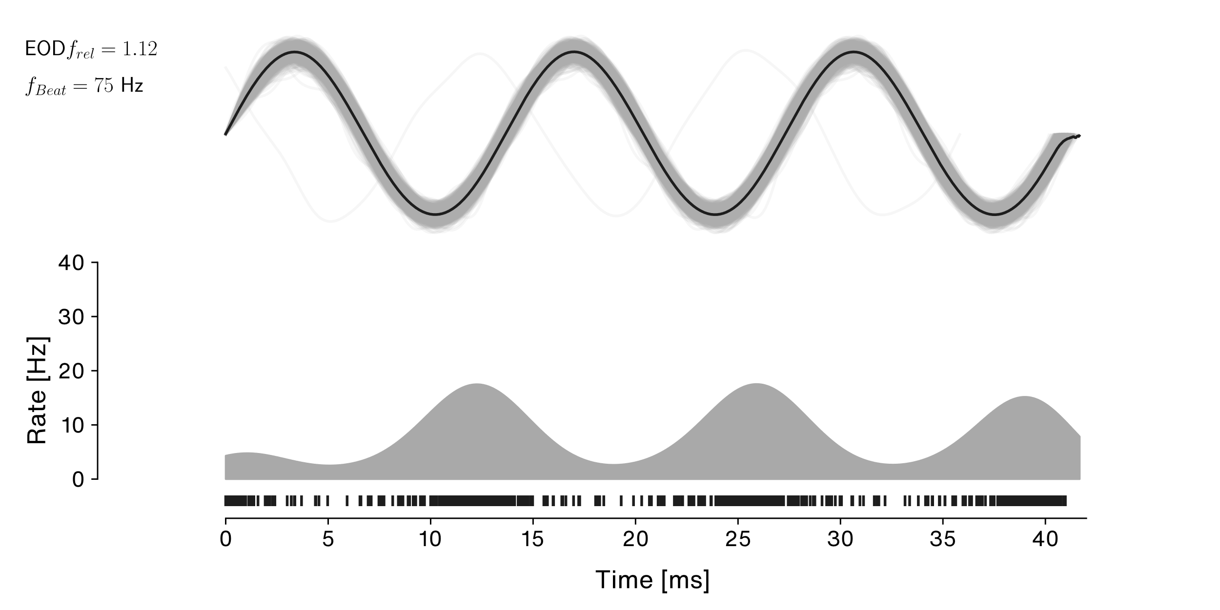
Results – Beat response

Slide 20
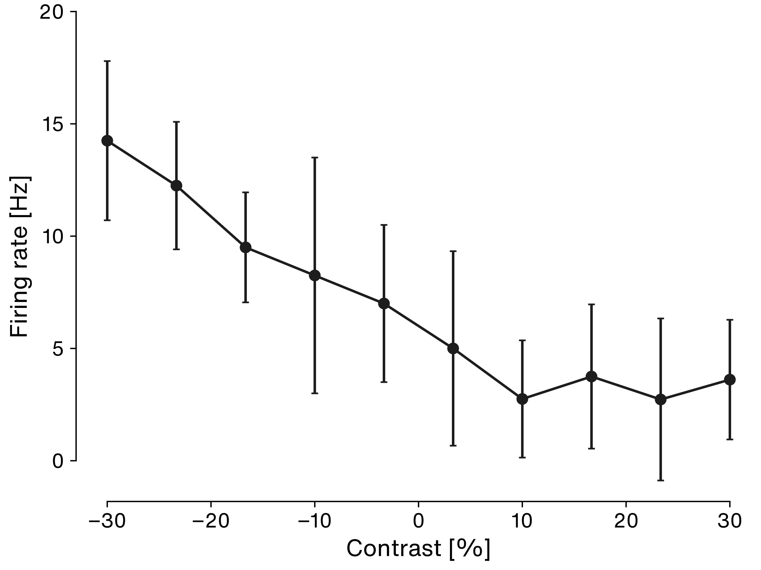
Results – FI curve

Slide 21
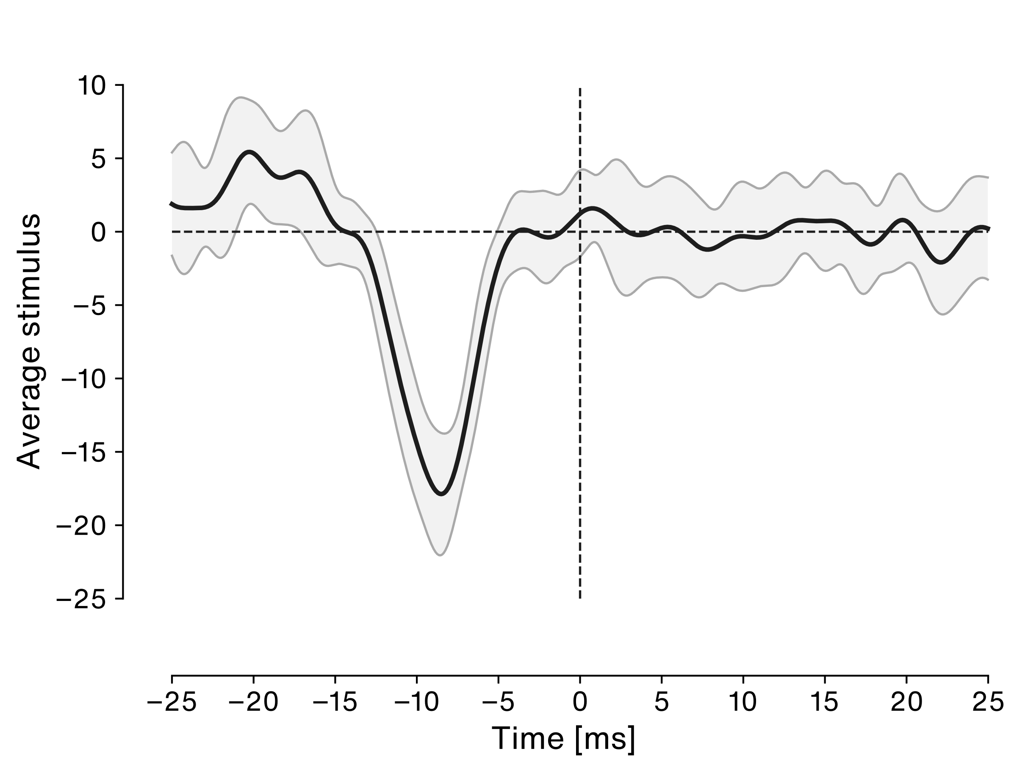
Results – Spike triggered average stimulus
Notes:
Small positive peak – indicates weak lowpass filter
Large negative peak – indicates strong highpass filter
Spikes at the troughs of a signal
Width of STA about 15 ms
Corresponds to s frequency of 1/0.015 = 65 Hz
Fits into the beat frequency ranges to which it is coupled

Slide 22
Introduction – ELL pyramidal cells
Electrode
Inhib. feedback
CLS
CMS
Superficial pyramidal cell
LS
MS
Deep pyramidal cell
Interneuron
P-Unit

Slide 23
Results – Baseline analysis
Show baseline, bursts and spikes

Slide 24
Results – Spikes and bursts
Show burst definition

Slide 25
Results – Spikes and bursts
Burst or spike during beat or chirp?

Slide 26
Results – Spike triggered average stimulus

Slide 27
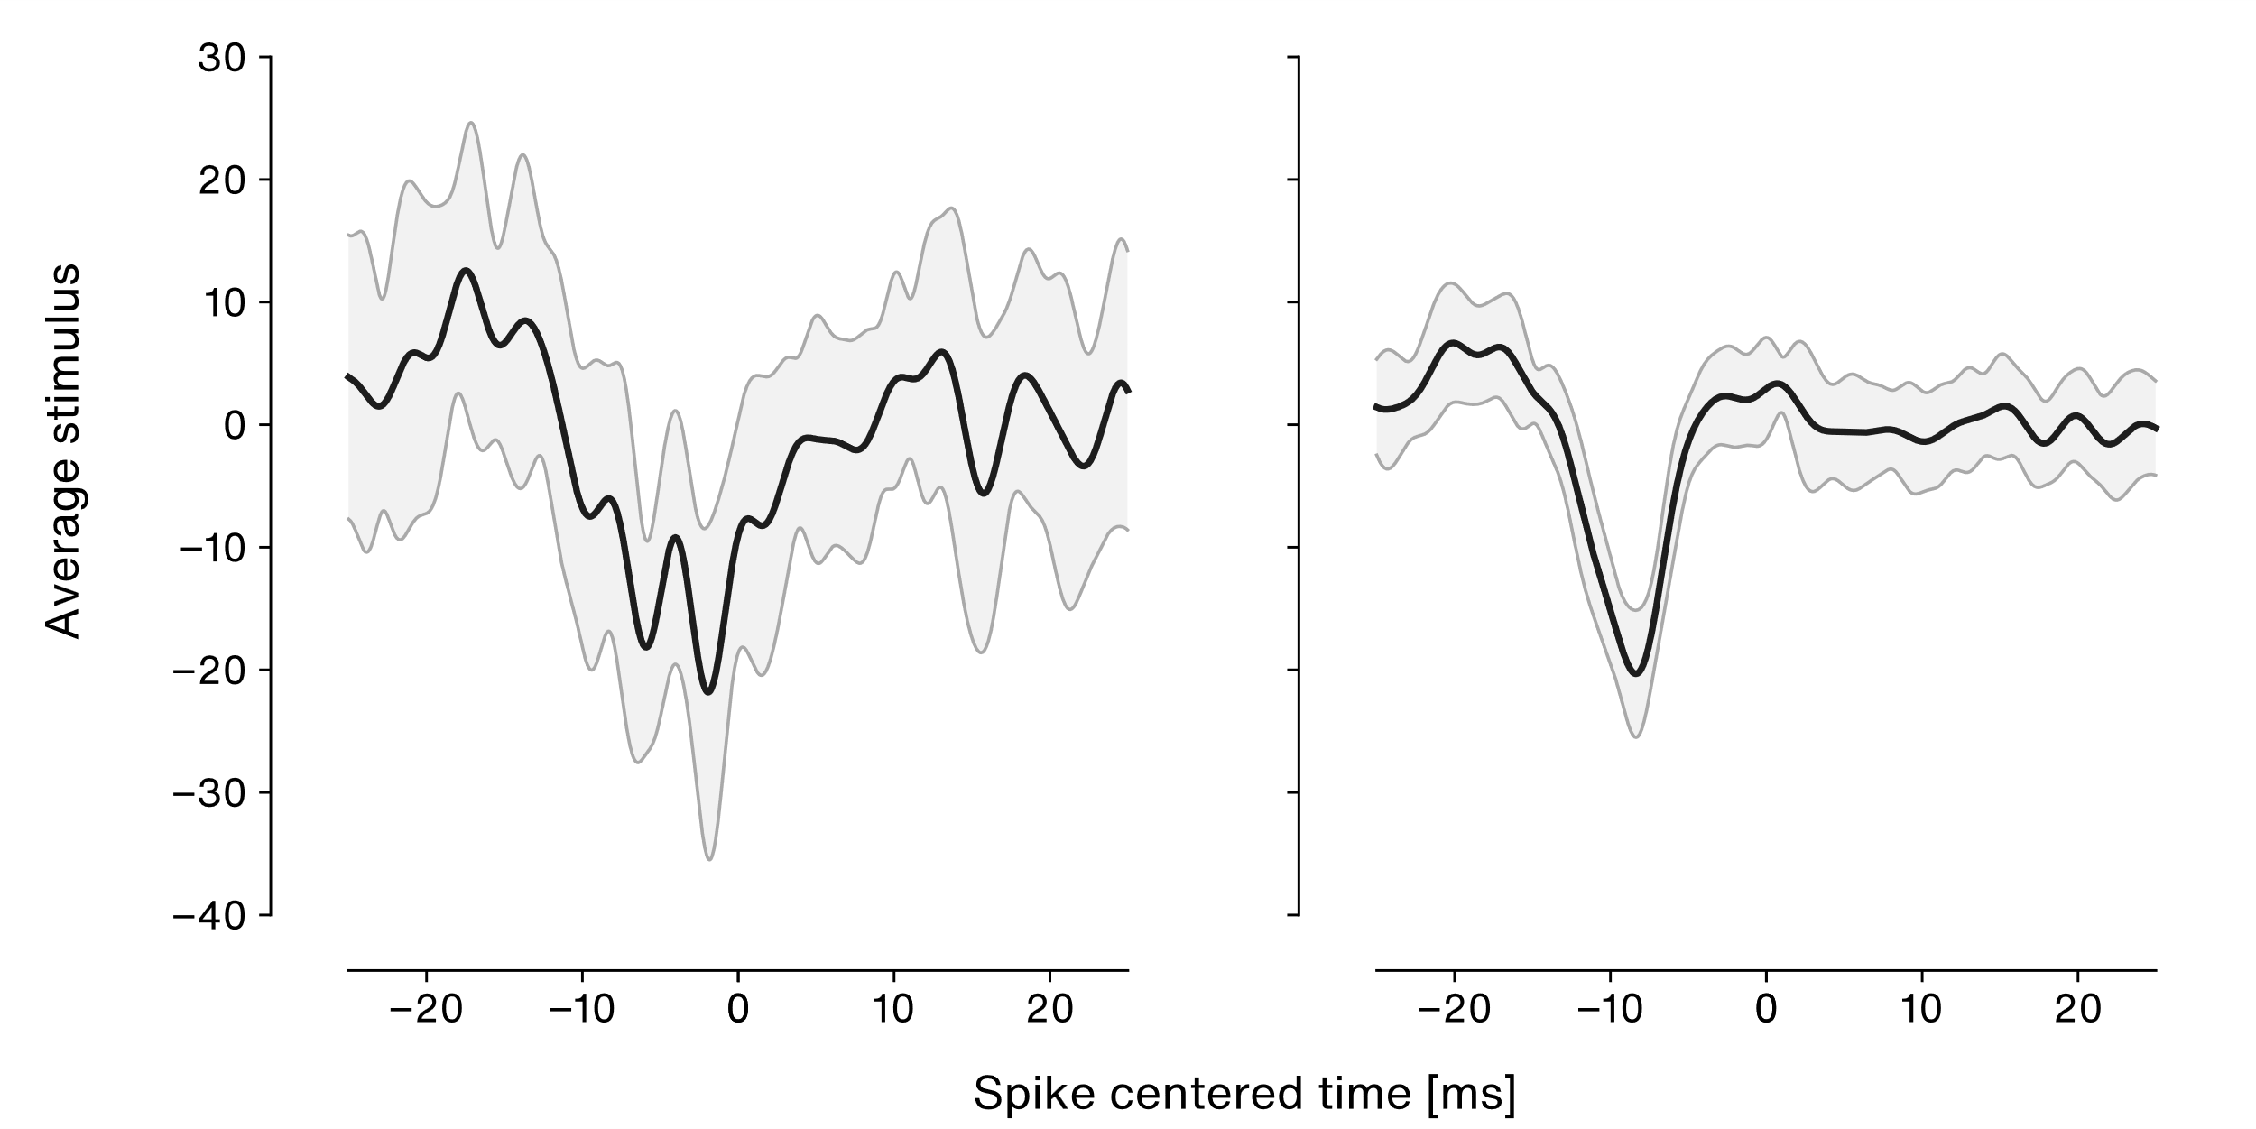
Results – Spike triggered average stimulus

Slide 28
Results – Stimulus reconstruction

Slide 29
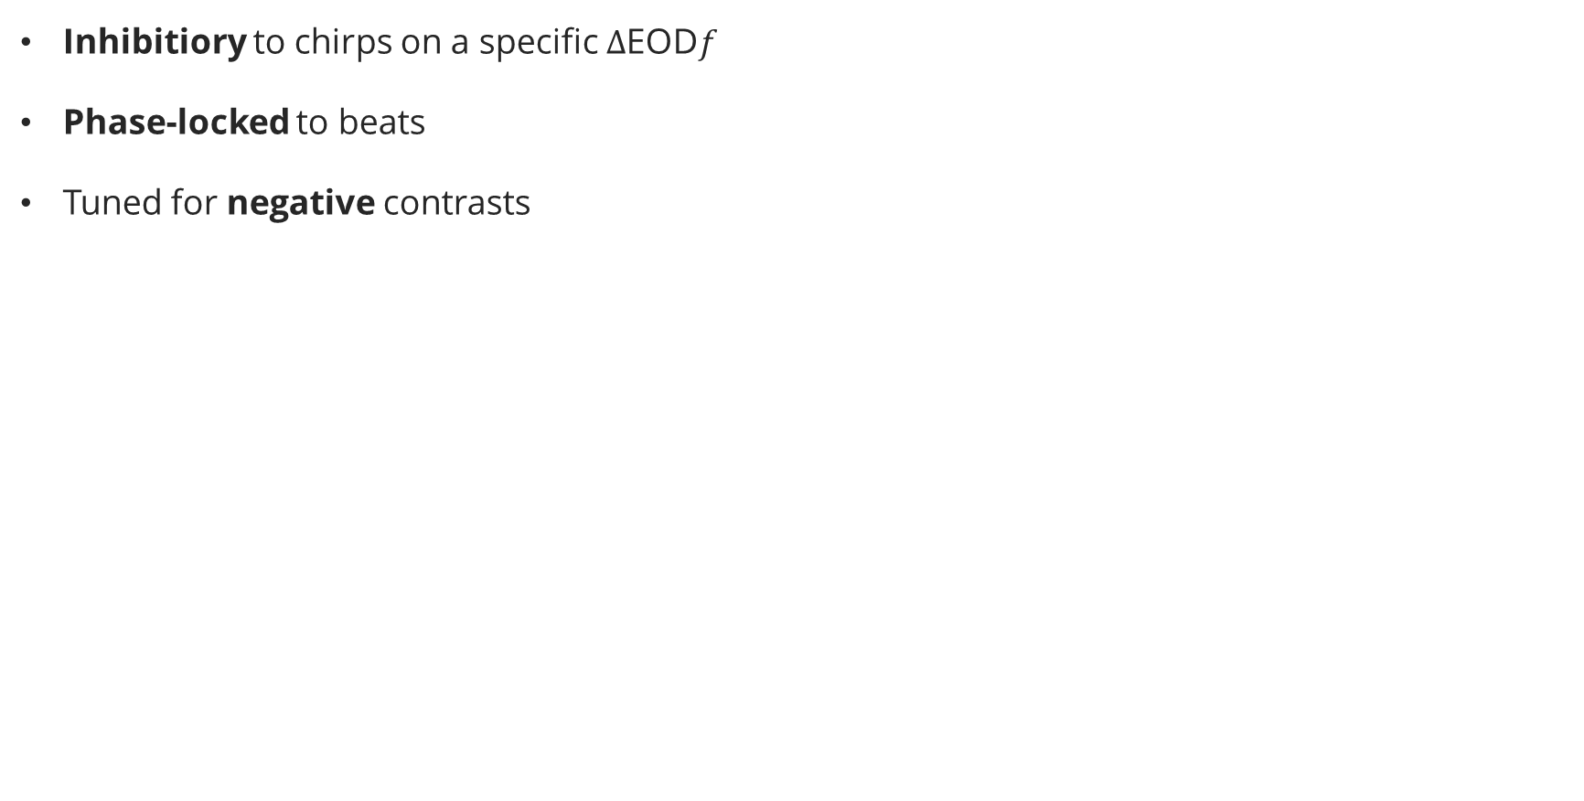
Discussion
Inhibitiory to chirps on a specific $Δ$EOD$f$
Phase-locked to beats
Tuned for negative contrasts

